Slide 1


SAG Droning
A compatible attachment for your drones

Slide 2
Introduction
Our application is for a universal attachment for drones.
The hardware device uses multiple sensors like Accelerometer, Barometer, Pressure and temperature in order to get the Customer a safe flight for their drones.
Our software application allows user to register, login and allows them to read the readings of the Sensors.
The app stores all the data on the database and it retrieves the data of sensor readings from the database.

Slide 3
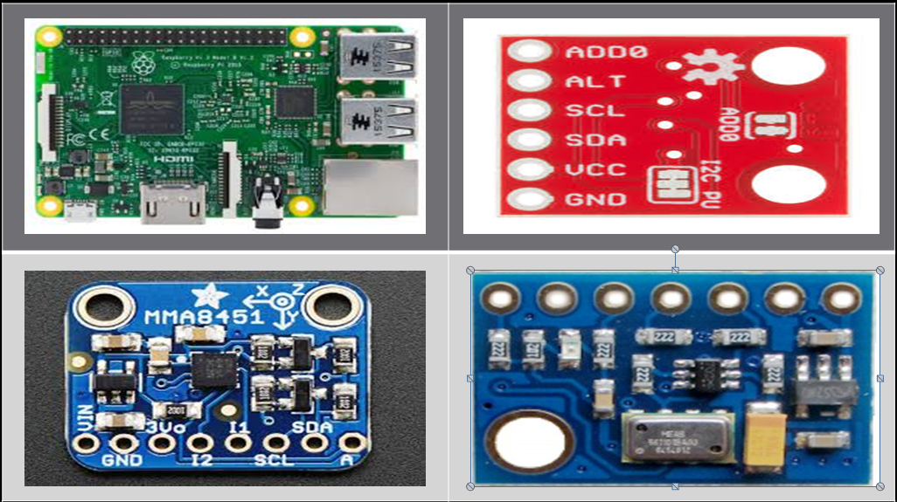
HARDWARE

Slide 4
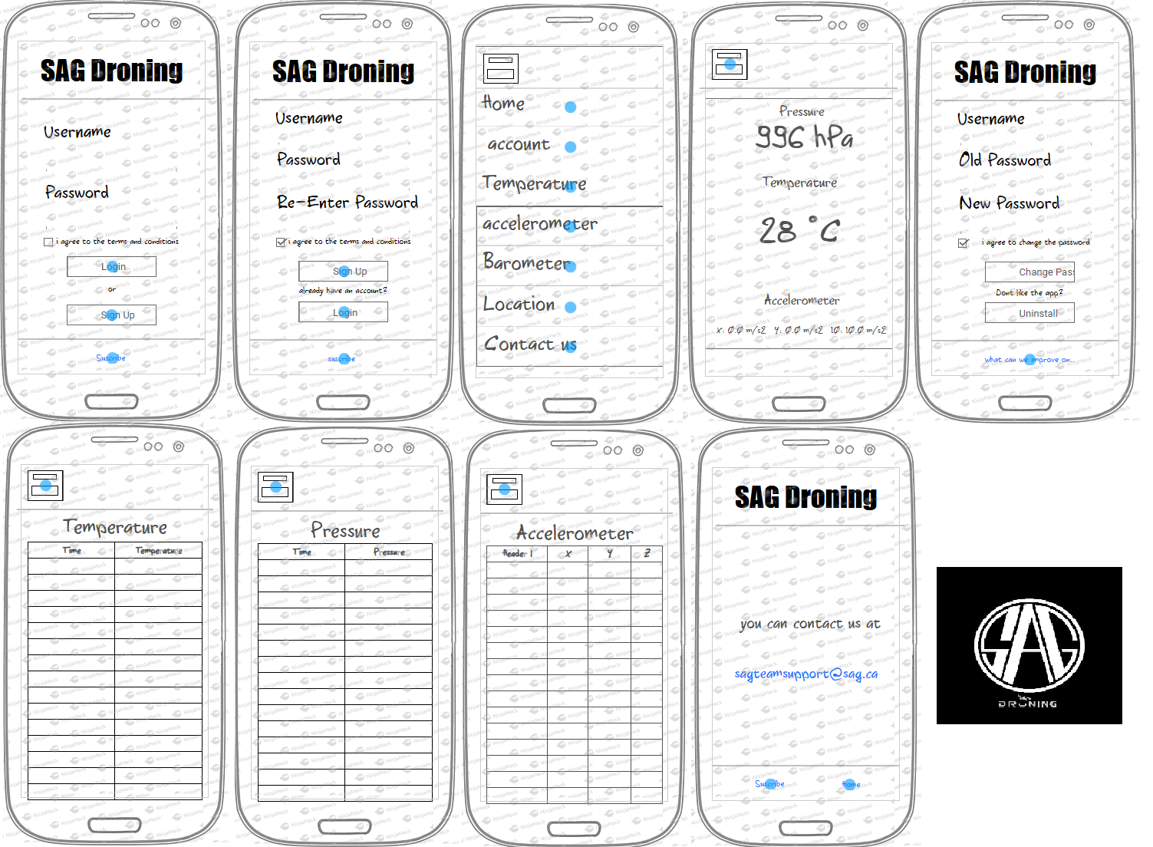
MOCK DESIGN

Slide 5
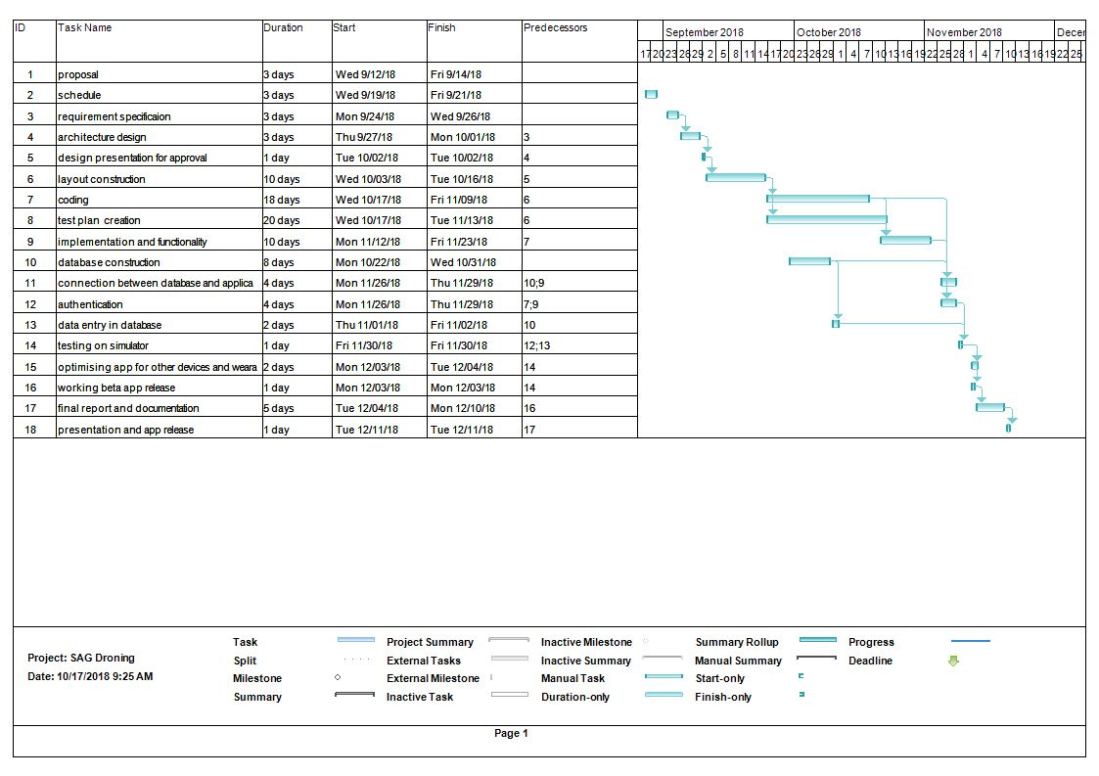
GANTT CHART

Slide 6
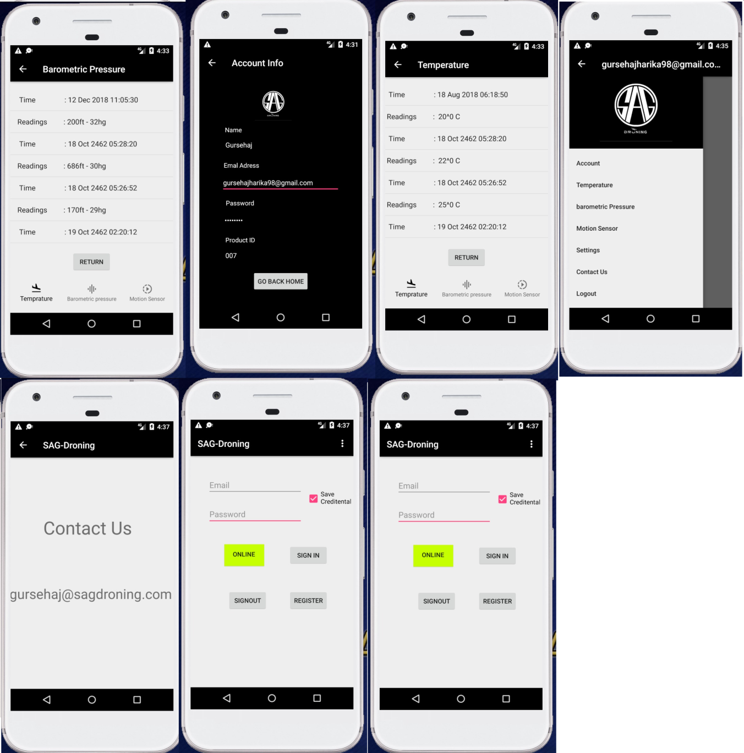
ACTUAL APPLICATION

Slide 7
FINAL PRODUCT
Our final design consists of multiple pages including login, register, data readings, contact us and many more.
The app can function on API 21 and above.
It solves a real world problem of Drone Technology.(safety first)
The app works on a mixture of codes that consists of more than 15 java classes.
It is ready to be uploaded on play store and compete with millions of app’s

Slide 8
TESTING
To test the application
Open the application
Go to registration page and register
Go to login page and login using the new information you registered on. Select save information.
Once logged in check all the pages like account, Temperature, and other pages
Logout and close the application
Open the application again and press login it will have all the saved information.

Slide 9
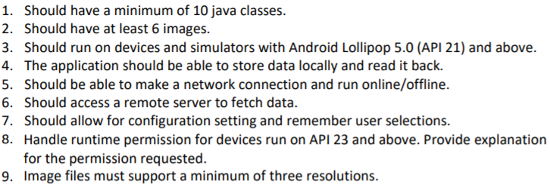
FUNCTIONALITY

Slide 10
CONTRIBUTIONS
SHUBHAM: developed the xml pages and mock designs at the start of the project
ARMAN: created the schedule, proposal and other documents.
Created all the custom logo and images for the app
Created and linked database.
Worked on readings page for all the sensors and contact us page
GURSEHAJ: Did most of the parts of the application
Created the login, registration and authentication. Created shared preferences, working on Multilanguage support app.

Slide 11
Future Update
We will connect the hardware with the database.
We will show the live readings directly from the hardware.

Slide 12
Hope you enjoyed it. Check out our application on github at https://github.com/GursehajHarika/SAG-Droning
THANK YOU

